Slide 1
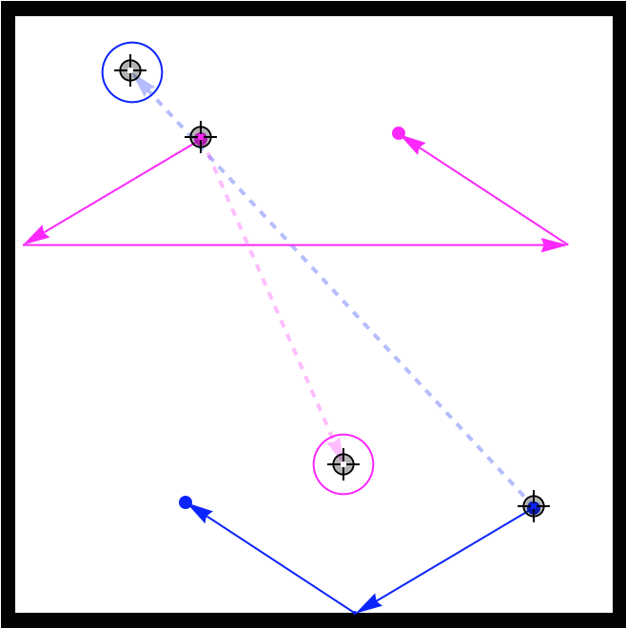
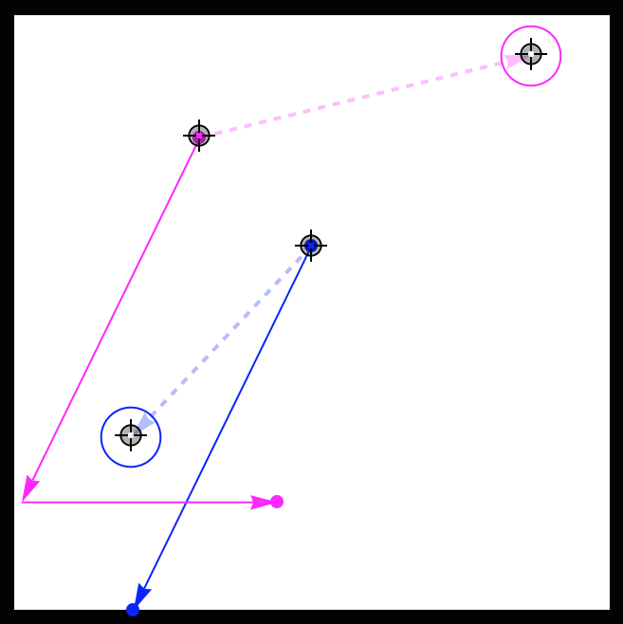
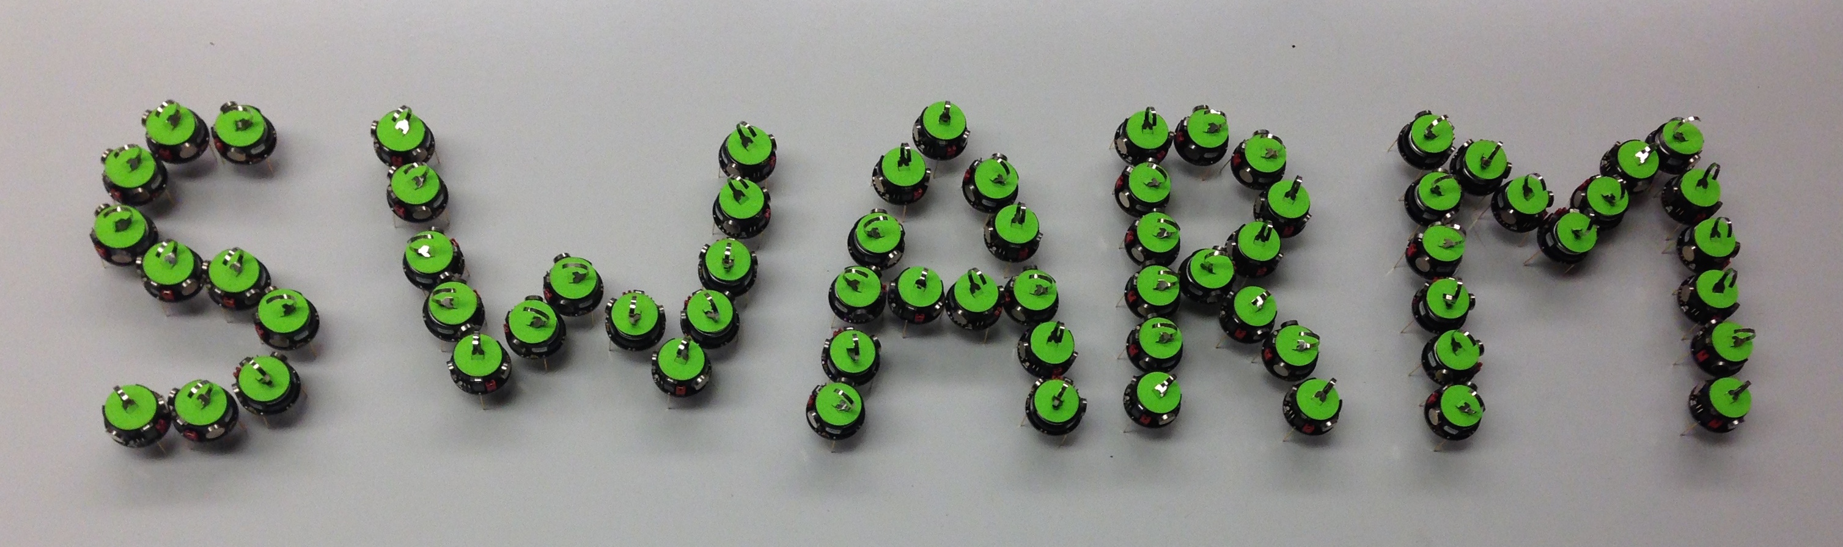

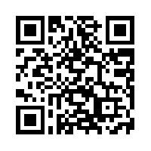


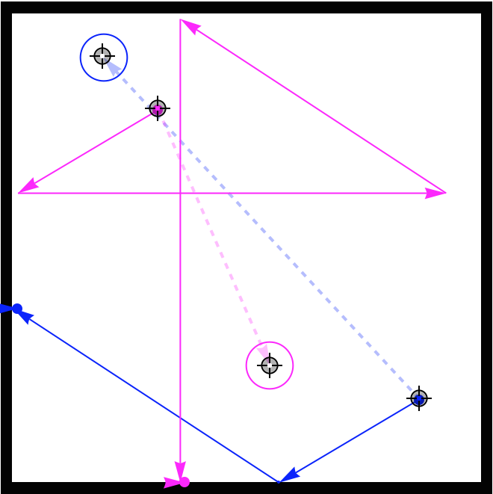
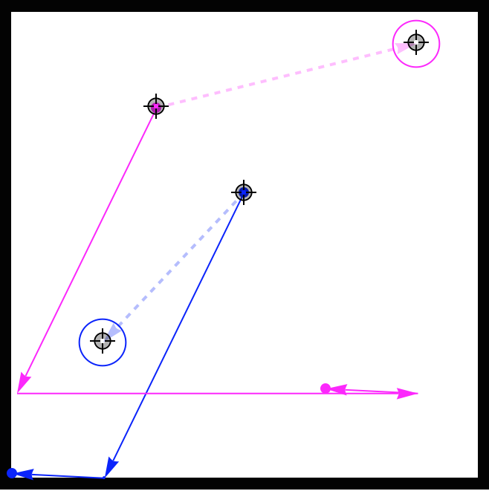
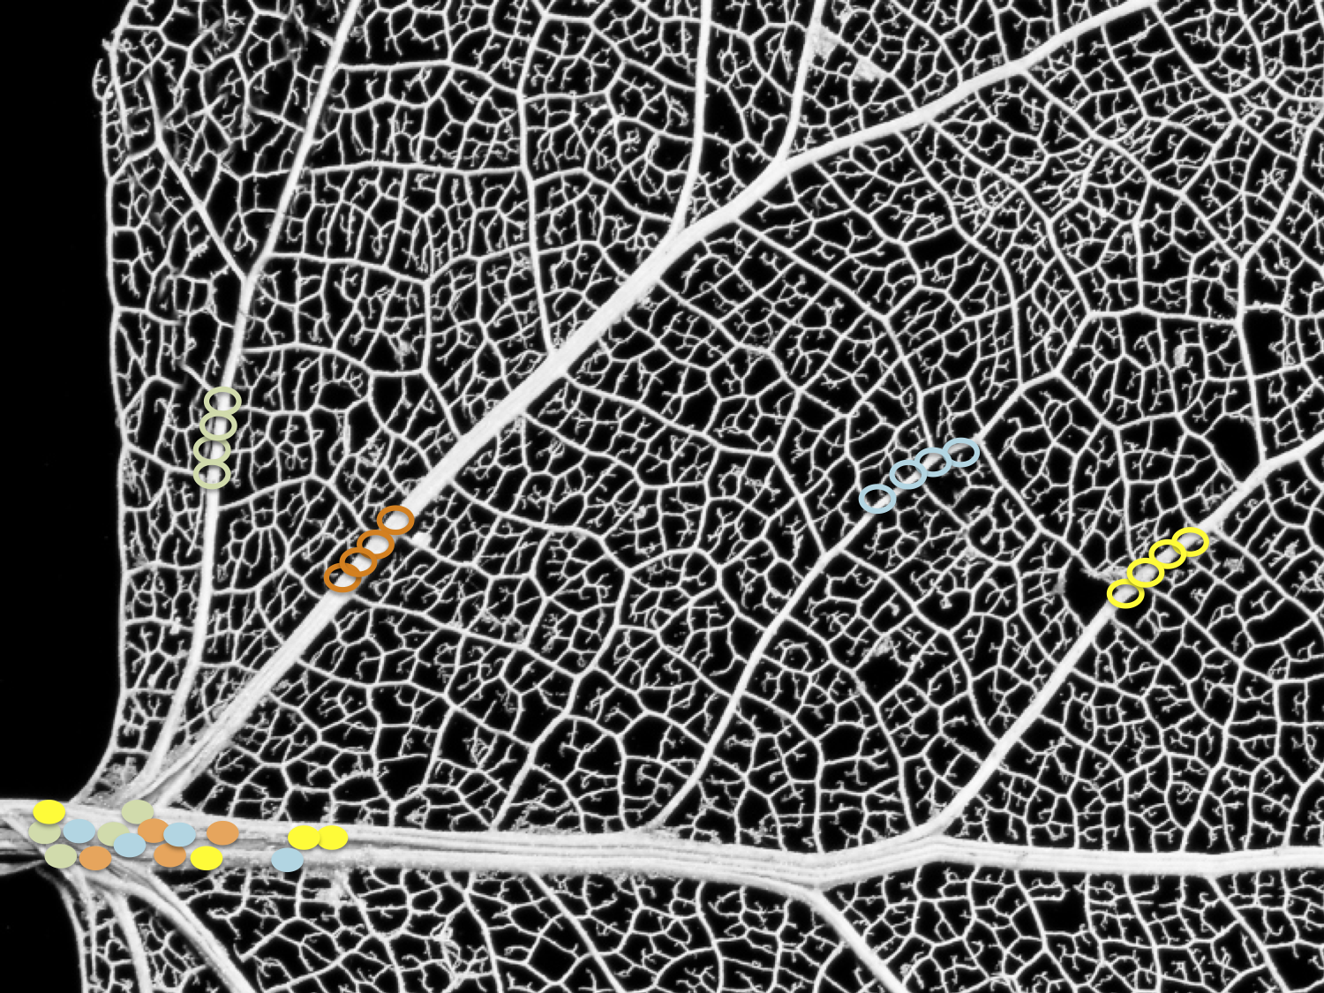
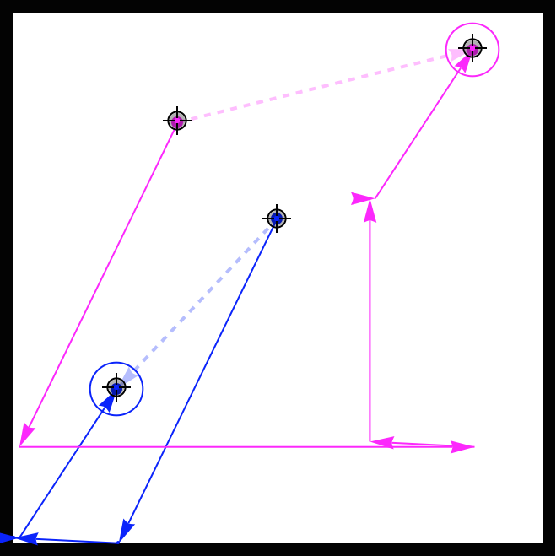
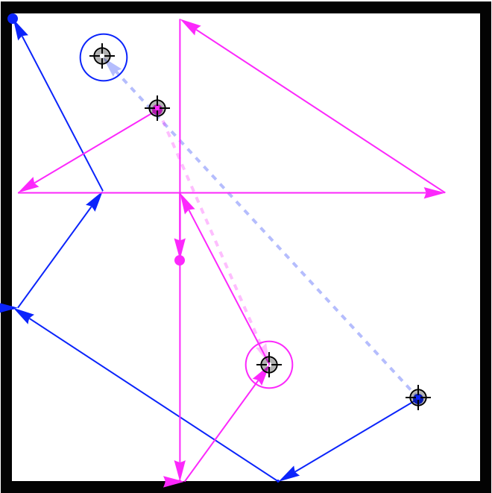
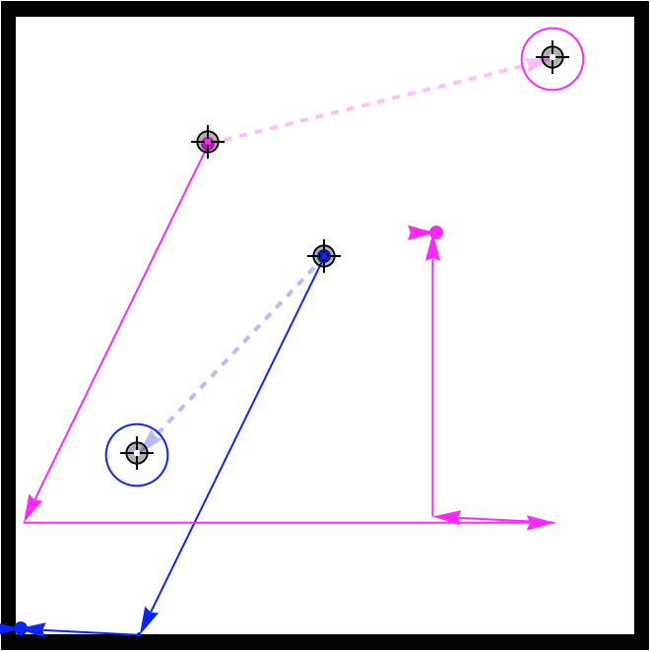
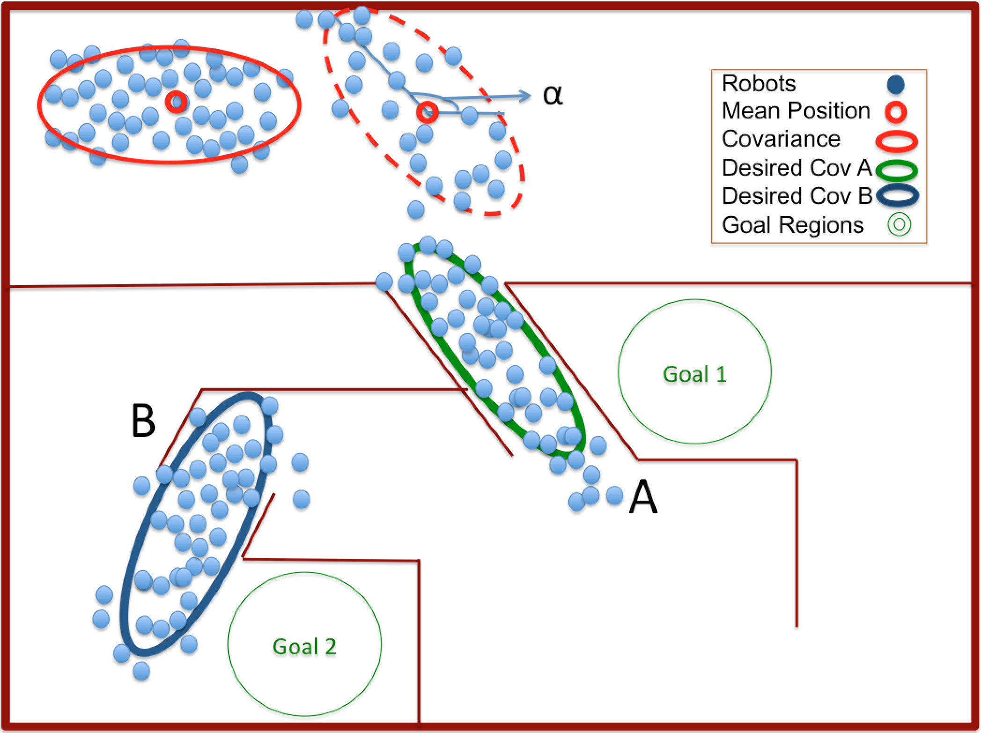
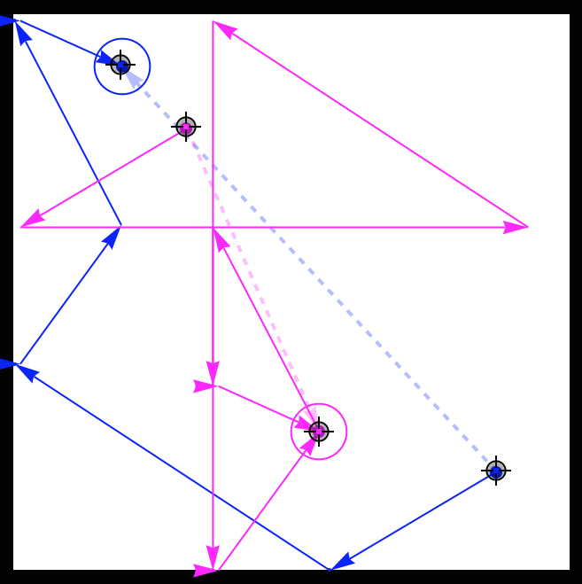
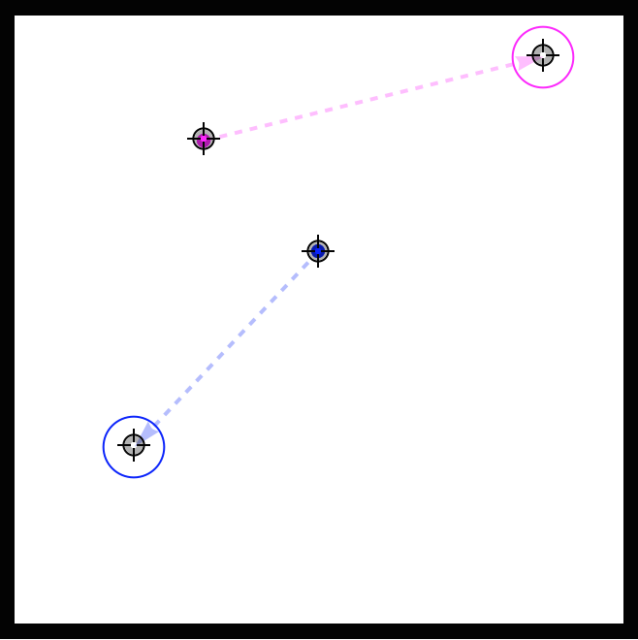
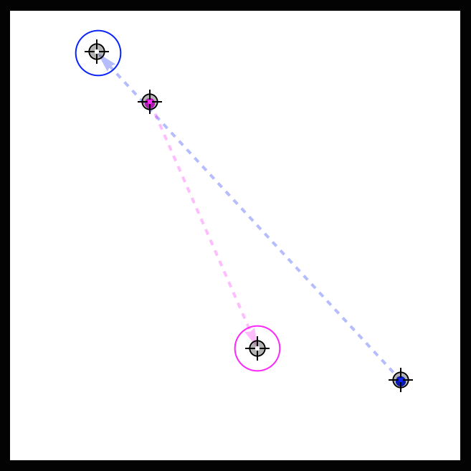
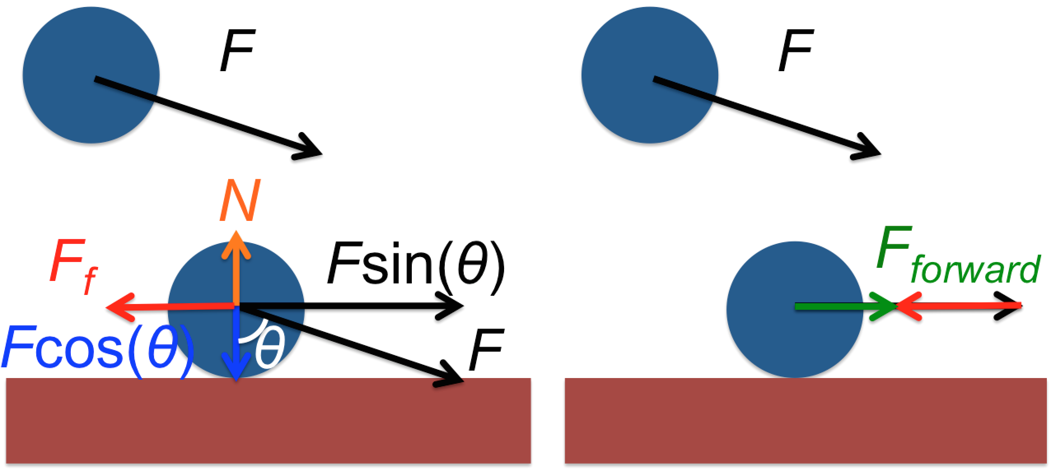
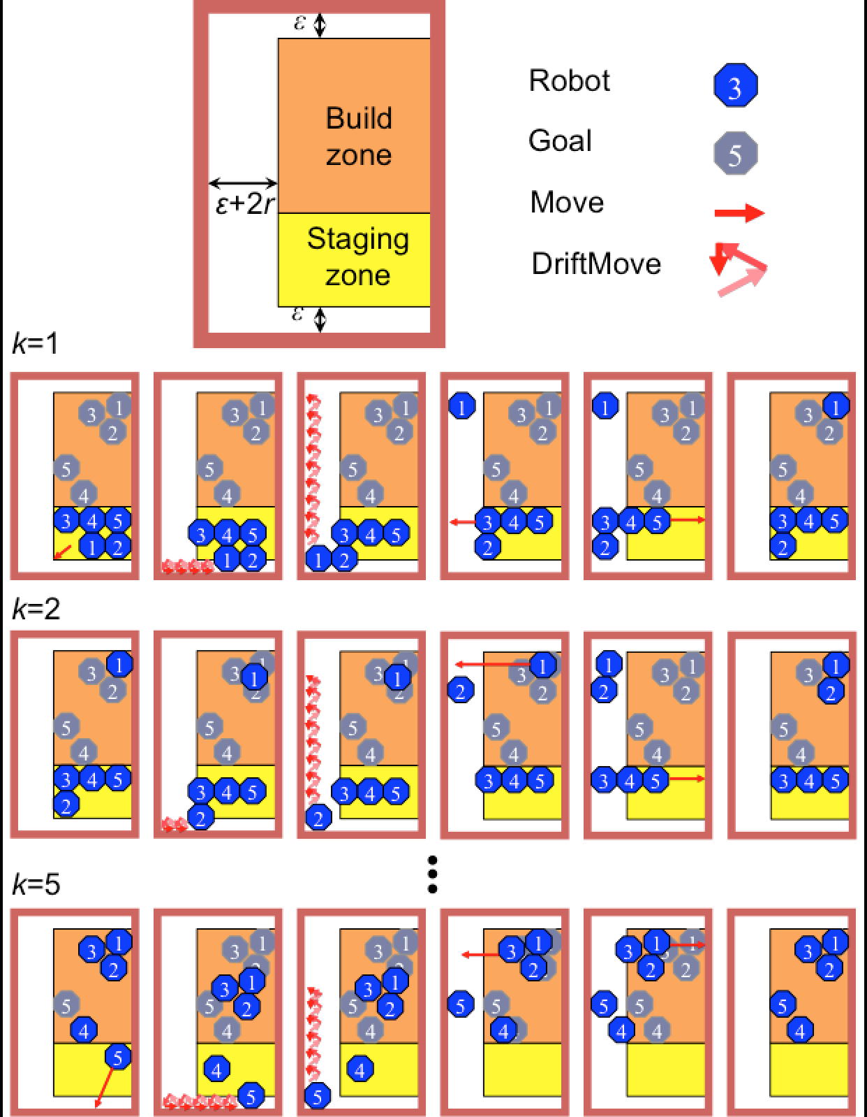
Shaping a Swarm Using Wall Friction and a Shared Control Input
Shiva Shahrokhi, Aaron T. Becker
sshahrokhi2@uh.edu, atbecker@uh.edu
Department of Electrical and Computer Engineering,
University of Houston
Website, C.V.
YouTube channel
Why Covariance Control?
Position Control
Vascular networks are common in biology
Global inputs means each member of the
swarm receives the same control input
Navigating a swarm using global inputs,
is challenging due to the many obstacles.
We designed an algorithm for controlling position of two robots
For simplicity we assume that friction is infinite.
Following this path we can get to the ending points when getting the same input.
We need to break symmetry
Using just vertical walls would not make correlation between x and y direction
Maintaining group cohesion while steering a swarm through an arbitrary maze requires covariance control.
Two robot positioning: switching positions using walls with infinite friction
Two robot positioning using the hardware setup and two kilobot robots.
The walls have nearly infinite friction,
The robot with the blue path is stopped by the wall until the light changes orientation
The orange robot in free-space is unhindered
Using Friction
Robot
Bottom Path
Top Path
Goal Positions
Friction is sufficient to break the symmetry
Wall friction reduces the force for going forward on a robot near a wall, but not for a free robot.
Multi Robot Control
Results
We can extend this algorithm to n robots position control
Future Opportunities
We used kilobots to show that wall friction is enough to control covariance.
Global Input: kilobots go to the brightest light source in the room
We showed that covariance control is possible
Implementing n robots position algorithm with kilobots
Using friction less than infinite and run the algorithm

